Slide 1
Gene Transfer Methods
By,
Dr. Ravindra Pathre
HOD, Assistant Professor Zoology,
Mss College Ambad

Slide 2
Contents
Definition of gene
Gene transfer Mechanism
Types
Bacterial Transformation
Conjugation
Mechanism
Application

Slide 3
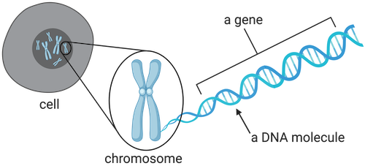
GENE …..?
A gene is the molecular unit of the Heredity of a living organism.

Slide 4
GENE TRANSFER MECHANIS ???
It is the mechanism where a particular gene is transferred from donor to recipient cells…
It is the insertion of copies of a gene into living cells.
The desired gene may be microinjected directly into the cell or it may be inserted into the core of a virus by gene splicing and the virus is allowed to infect the cell for replication of the gene in the cell’s DNA.

Slide 5
TYPES
Bacterial transformation
Transduction
Conjugation
Host cell restriction
Complementation
Transfection

Slide 6
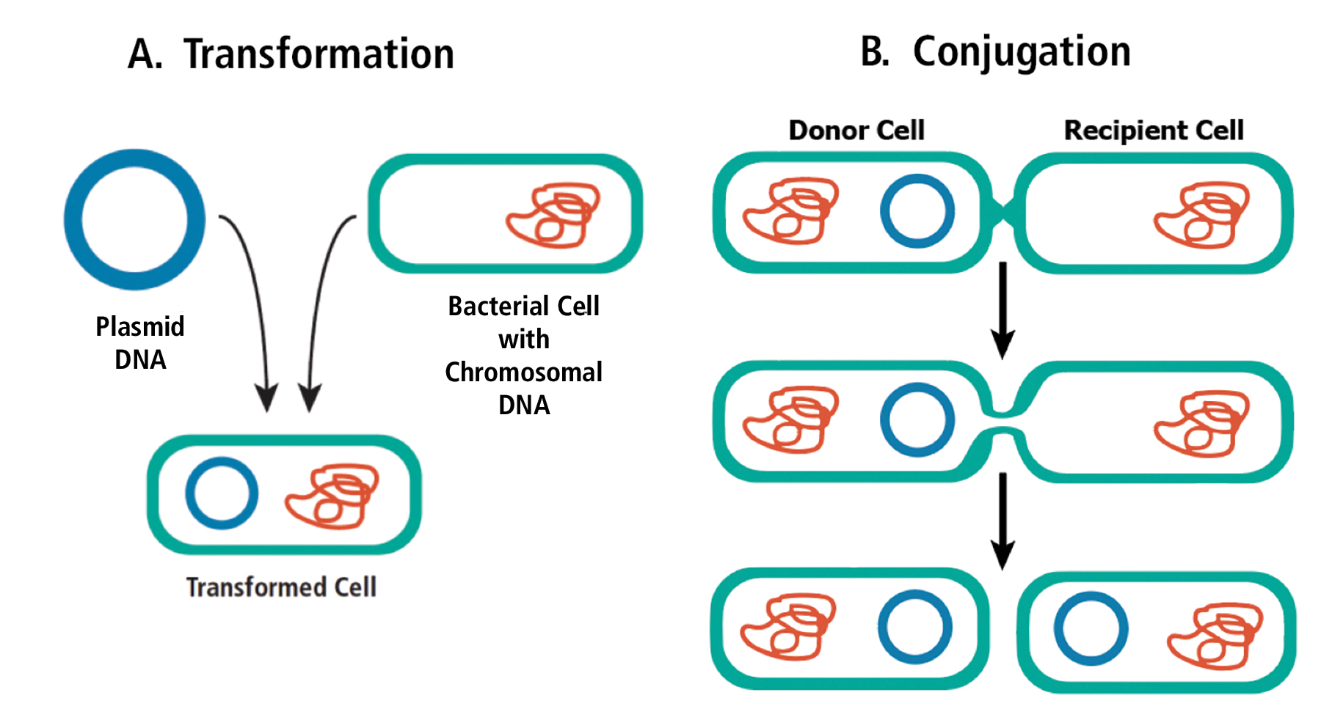
TRANSFORMATION
The process by which a donor DNA molecule is taken up from the external environment and incorporated into the recipient cell genome.

Slide 7
HISTORY
First discovered by Frederick Griffith in 1928 in diplococcus pneumoniae.
In 1944, Avery and co-workers showed that DNA was responsible for transformation.

Slide 8
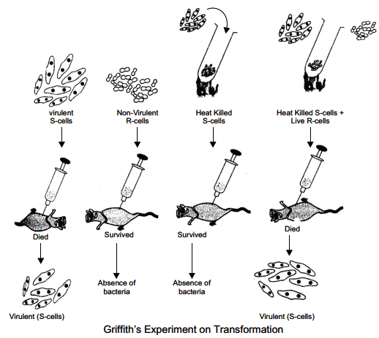

Slide 9
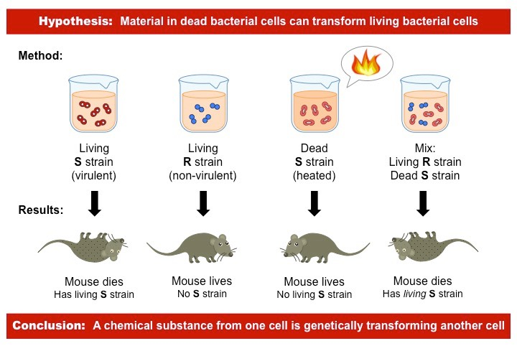

Slide 10
KEY POINTS
Energy-requiring process.
Proteins and enzymes are required.
The maximum frequency of competent cells during the late log phase.
Naturally occurring transformation.

Slide 11
TYPES
NATURAL TRANSFORMATION
It is bacterial adaptation for DNA transfer that depends on the expression of numerous bacterial genes.
Competent development in Bacillus subtilis requires 40 genes.
Usually requires bacteria of the same species.

Slide 12
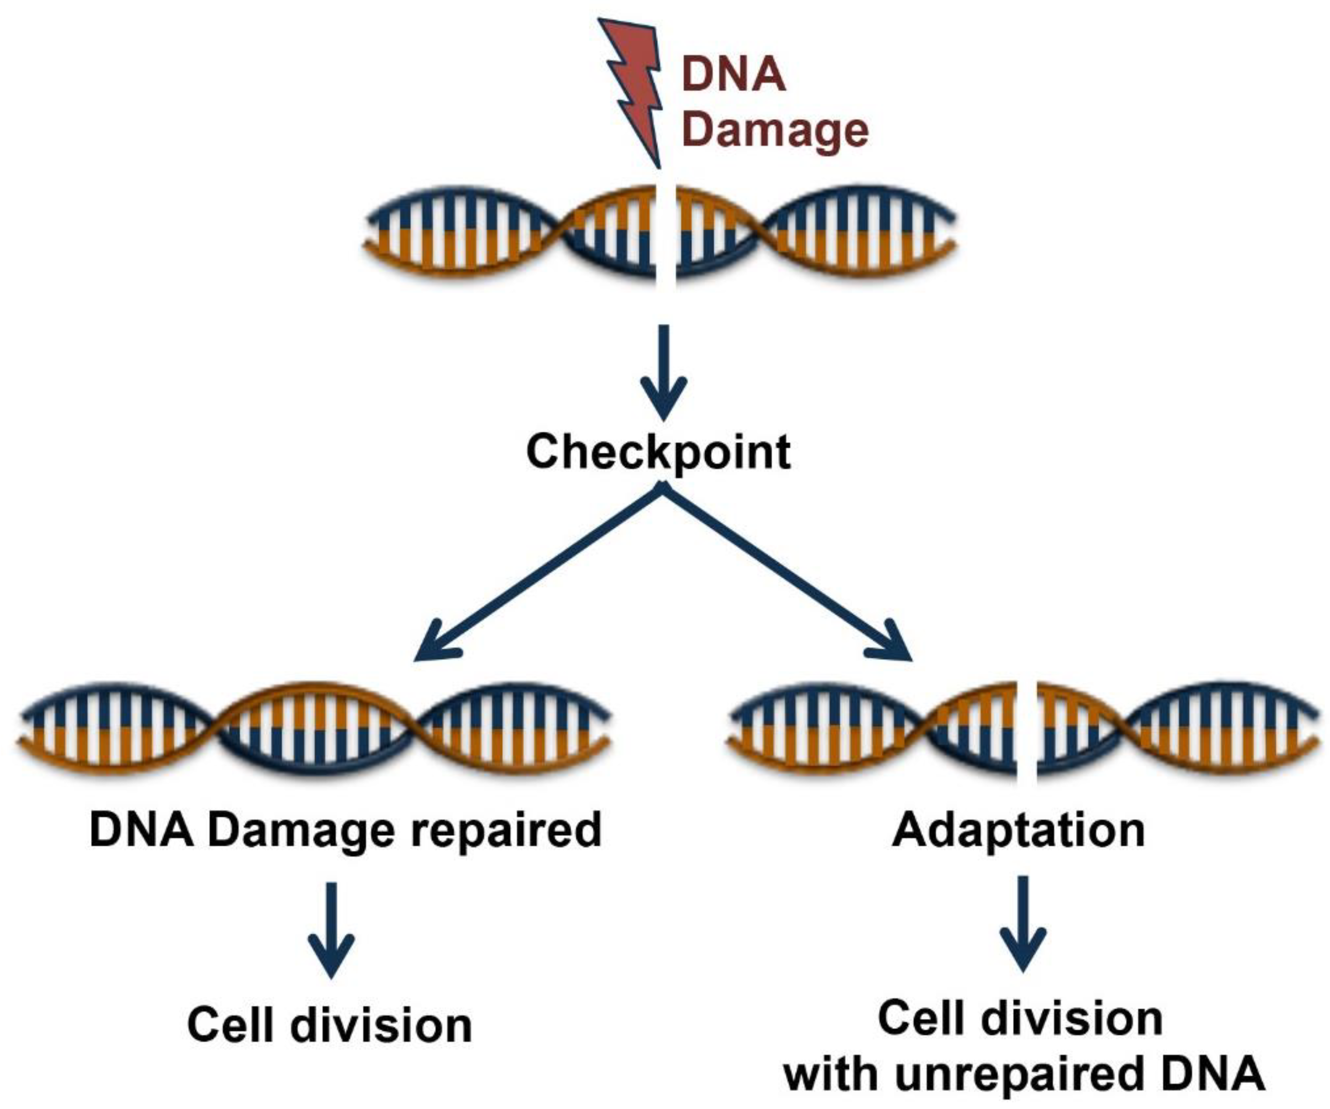
ADAPTATION FOR DNA REPAIR
Competence is induced by DNA-damaging conditions.
Mitomycin C and Fluoroquinolone.
UV light

Slide 13
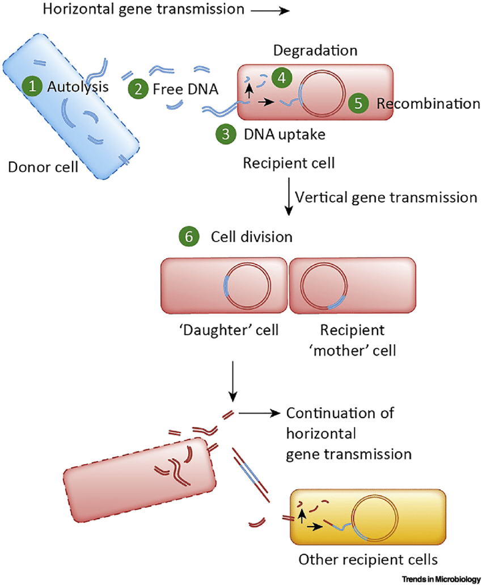

Slide 14
STEP -1
A competent cell binds a large double-stranded fragment of DNA at specific receptor sites on the surface of the bacterium.
One of the DNA strands is hydrolyzed by a membrane-bound exonuclease, providing energy to help DNA transport across the membrane.
STEP -2
Induced proteins bind to single-stranded donor fragments.

Slide 15
STEP -3 (A)
The single-stranded fragments of DNA are coated with DNA–binding protein and recombination proteins search for the same or very similar DNA sequences in the chromosome of the recipient cell.
STEP-3 (B)
The remainder of the ss DNA fragment is degraded.

Slide 16
APPLICATION
Transformation is one of the many ways of today to create recombinant DNA, DNA in which genes from two different sources- many times different species- are combined and placed into the same molecule or organism. This manipulation of genes is called genetic engineering and has many practical applications in the world today.
This is a very basic technique that is used on a daily basis in a molecular biological laboratory. The purpose of this technique is to introduce a foreign plasmid into a bacteria and to use that bacteria to amplify the plasmid in order to make large quantities of it. This is based on the natural function of a plasmid: to transfer genetic information vital to the survival of the bacteria.

Slide 17
thank you

